Slide 1
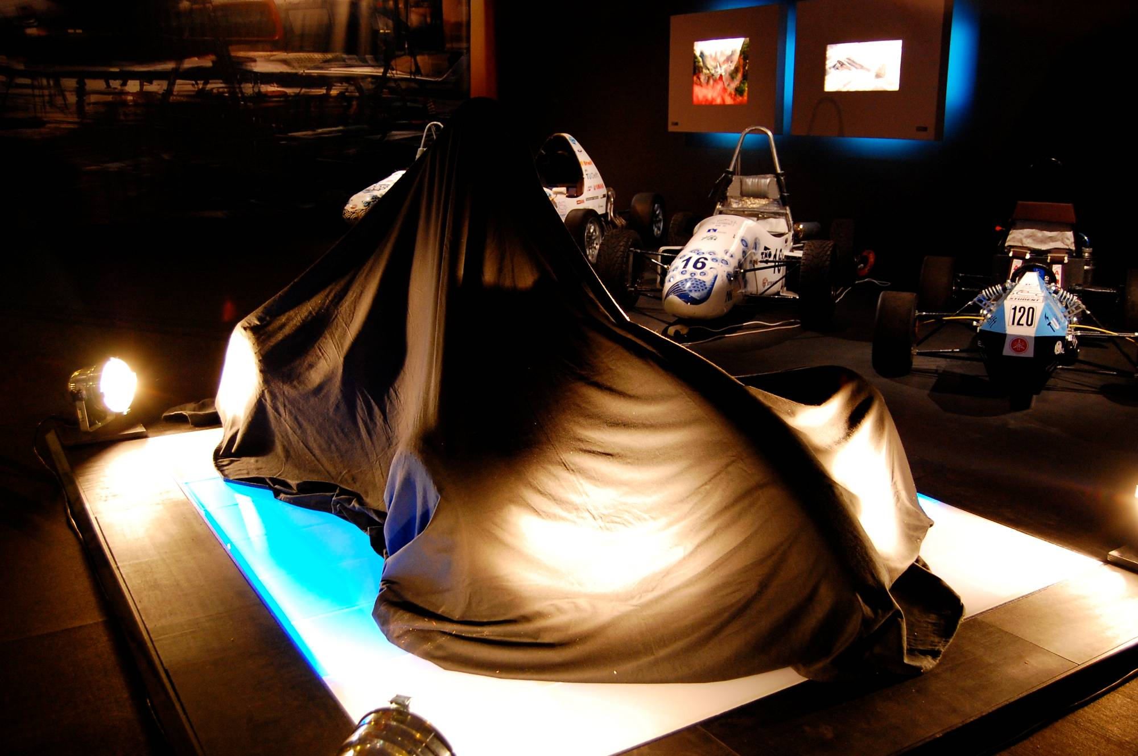
Launch of the Razor
The Ultimate Weekend Racer
Name
4 July, 2007

Slide 2

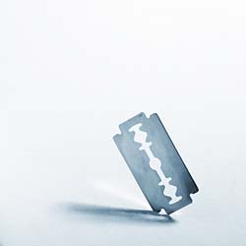

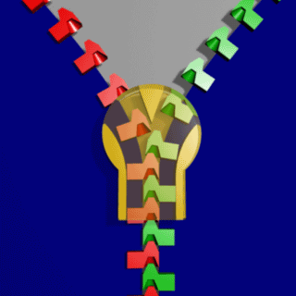
we
you

Slide 4
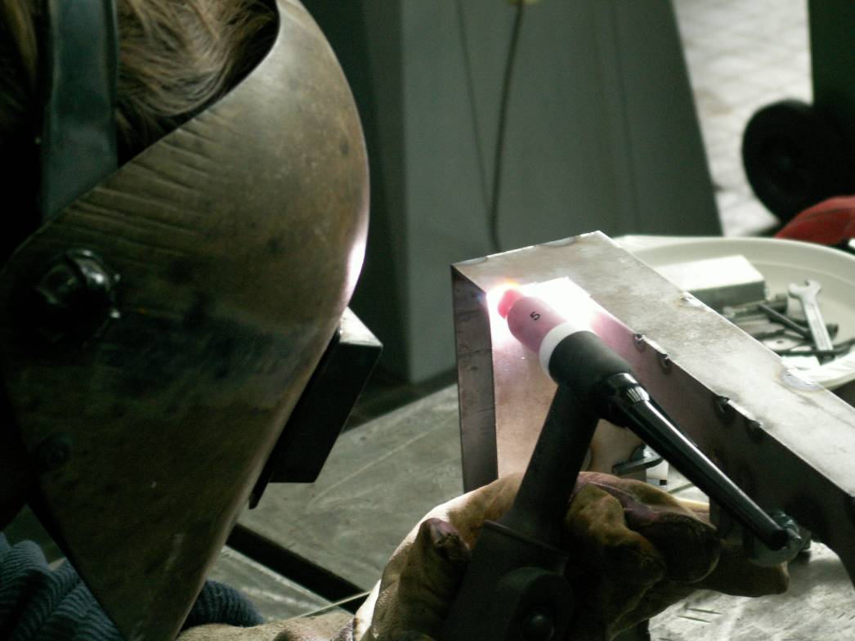
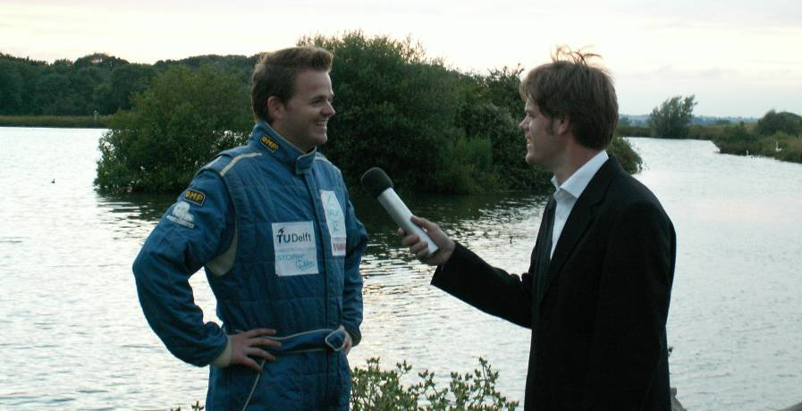
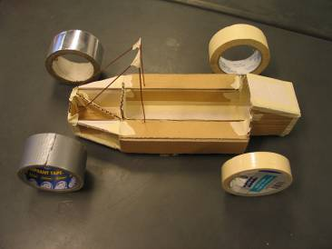
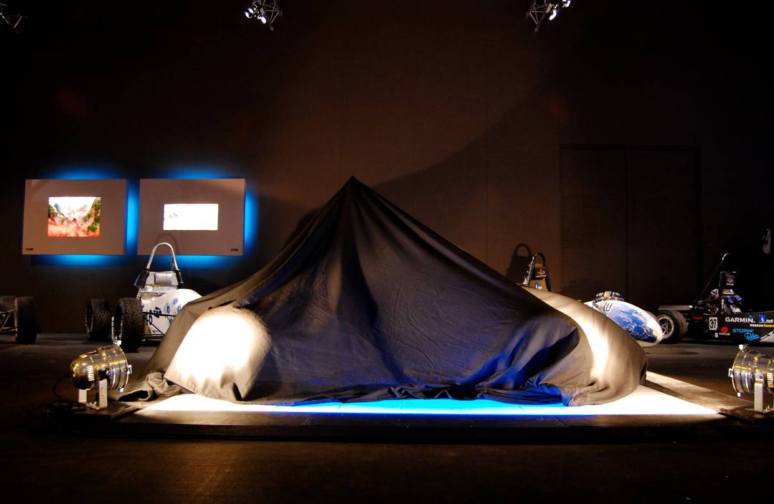
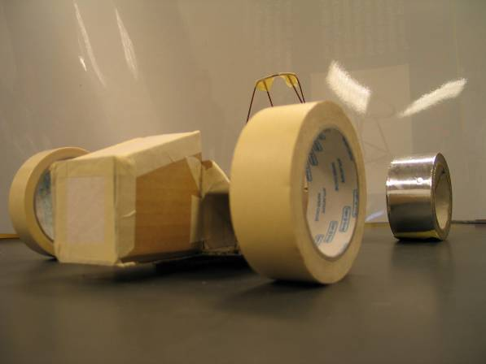
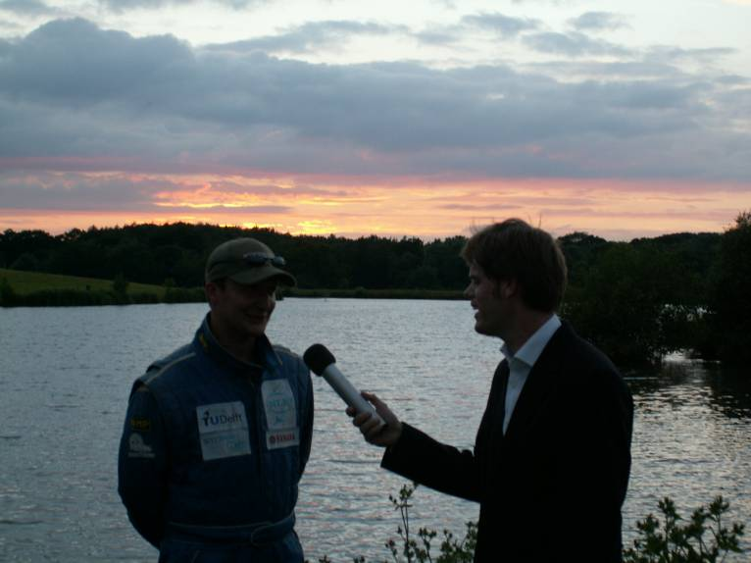
Contents
Market Analysis
Concept & Design
Razor
Production
Finance
Marketing
Conclusion

Slide 5
Market Europe
Poll at
Zandvoort & Go-kart
tracks
150 K
Cars per year
< 100
Karting
F Ford
GP2
F1

Slide 6
Market Europe
Go-kart tracks
150 K
Race Tracks
Cars per year
< 100
Karting
F Ford
GP2
F1

Slide 7
Market Europe
+New drivers !
150 K
?
Cars per year
< 100
Karting
F Ford
GP2
F1

Slide 8
Market Europe
+New drivers !
150 K
?
Cars per year
< 100
Karting
F Ford
GP2
F1

Slide 9
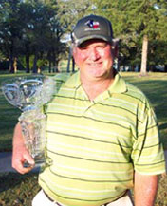
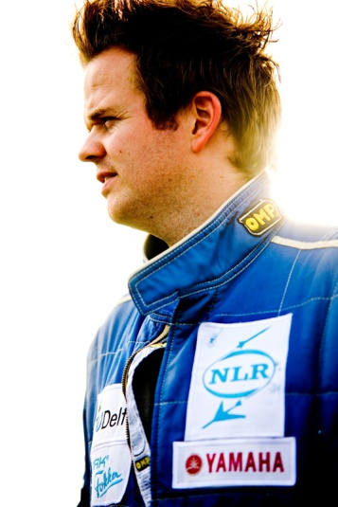
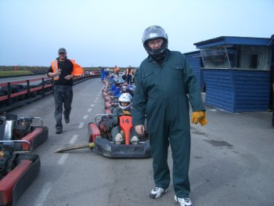
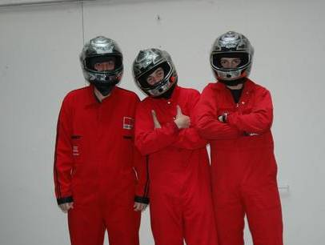
Market Europe
Market Europe
+New drivers !
150 K
Ace
Rookie
?
Cars per year
< 100
Karting
F Ford
GP2
F1
9

Slide 10
Market Europe
$ 5 K
150 K
$ 125 M
?
Cars per year
$ 25 K
$ 50 K
$ 5.000 K
5 K
$ 100 K
< 100
Karting
F Ford
GP2
F1

Slide 11
Market Europe
$ 5 K
150 K
$ 125 M
?
Cars per year
$ 25 K
$ 50 K
$ 5.000 K
5 K
$ 100 K
< 100
Karting
F Ford
GP2
F1

Slide 12
Market Europe
Ace
Rookie

Slide 13
Design input
Aesthetics
Repairability
Power
Weight
Price
Service
Handling
Transport
Adjustability
Safety

Slide 14
Rookie drivers
Aesthetics
Maintenance
Power
Weight
Price
Service
Handling
Transport
Adjustability
Safety

Slide 15
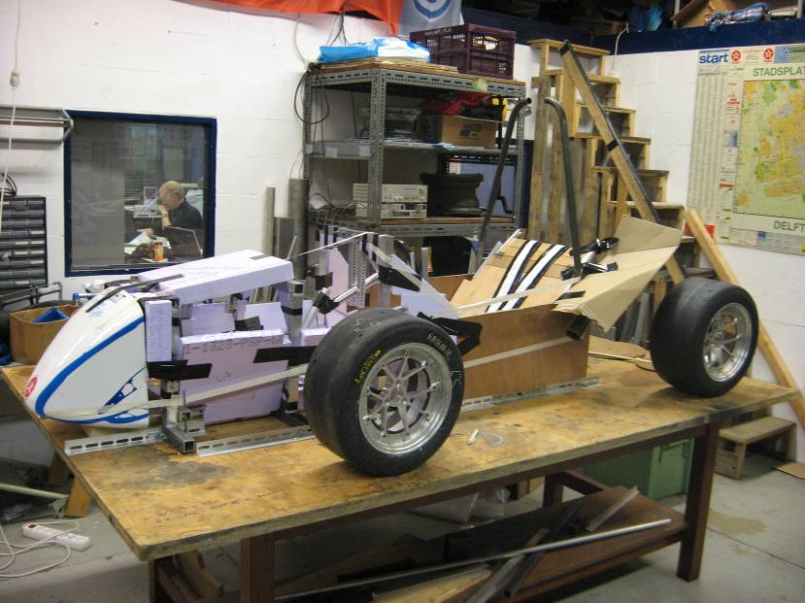
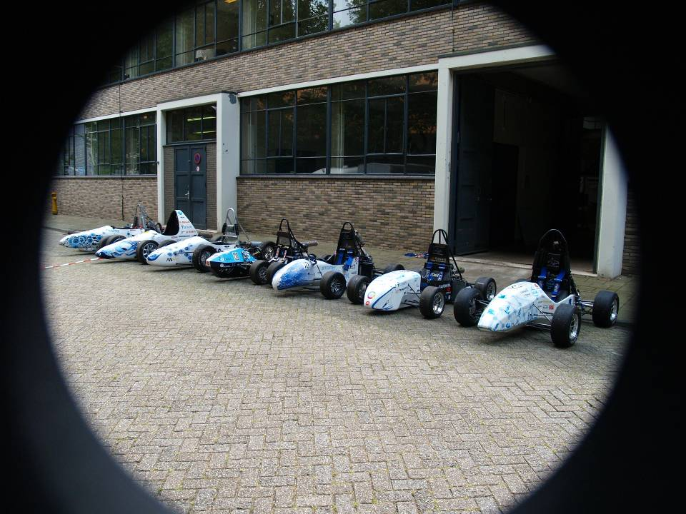
Aesthetics

Slide 16
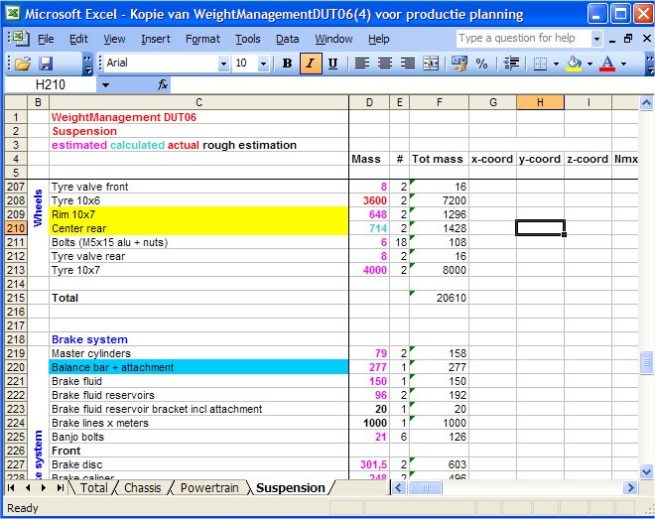
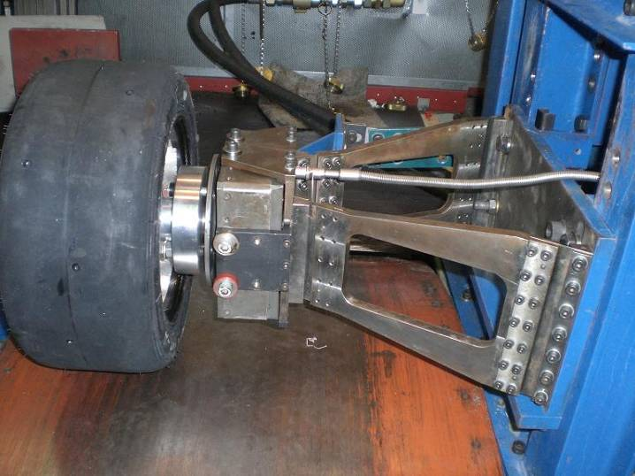
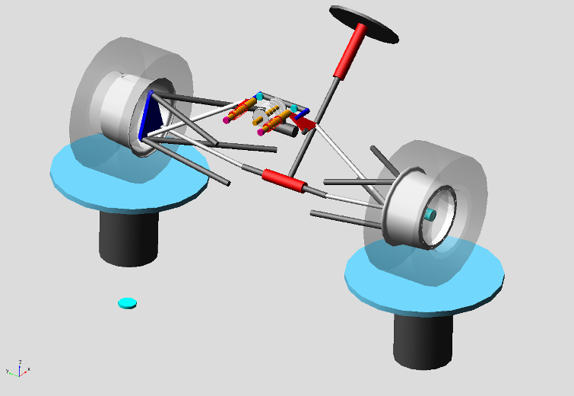
Handling

Slide 17
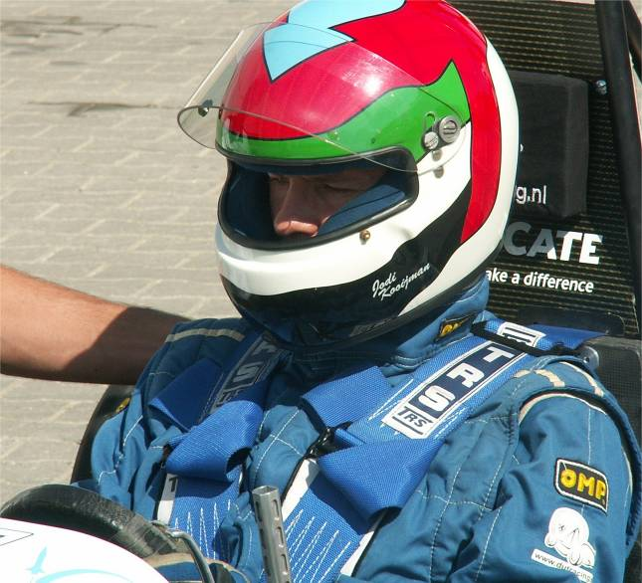
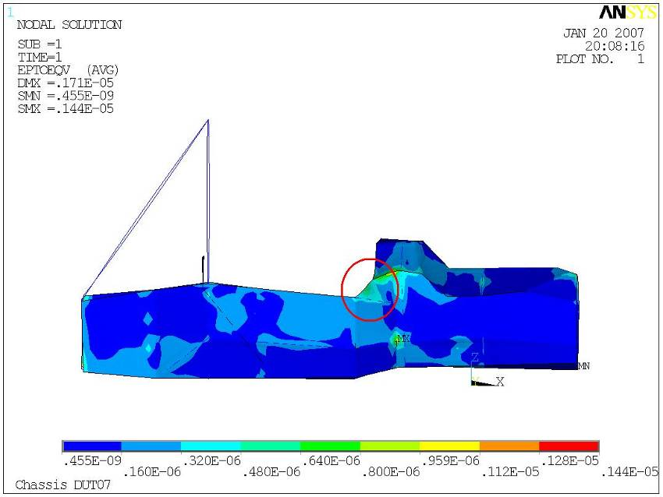
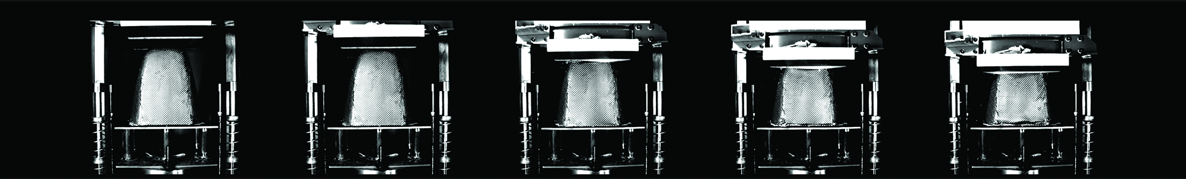
Safety

Slide 18
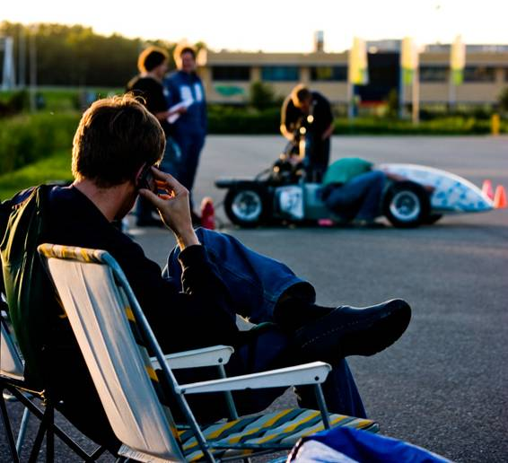
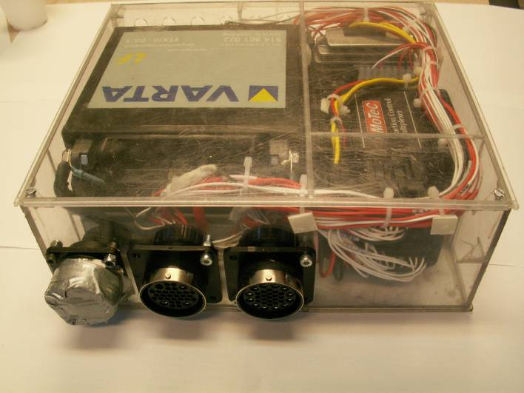
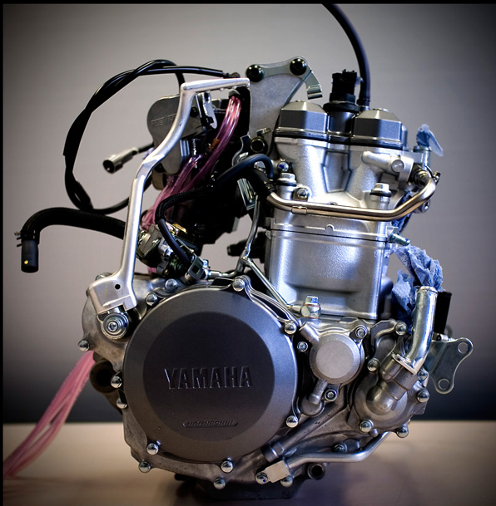
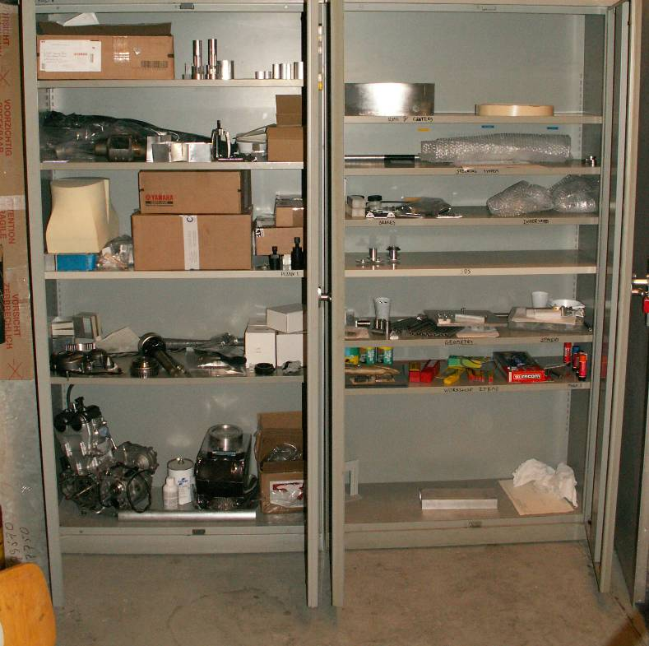
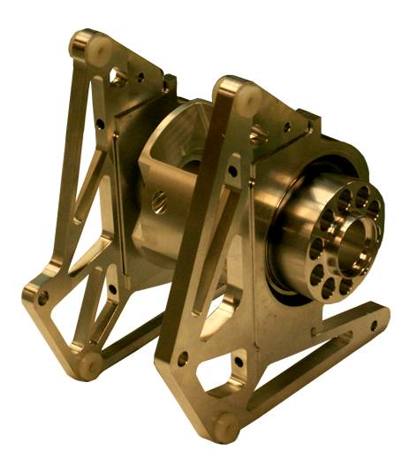
Service & Maintenance

Slide 19
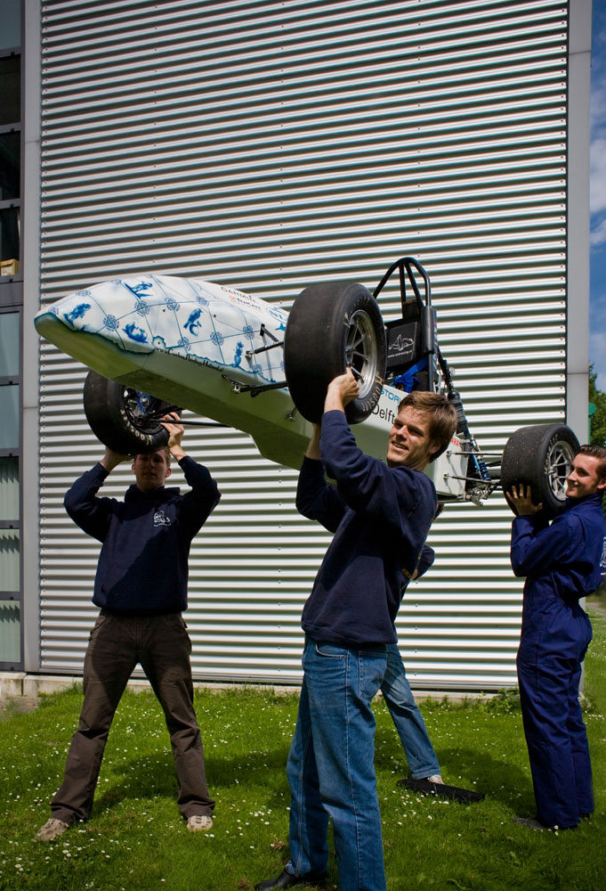
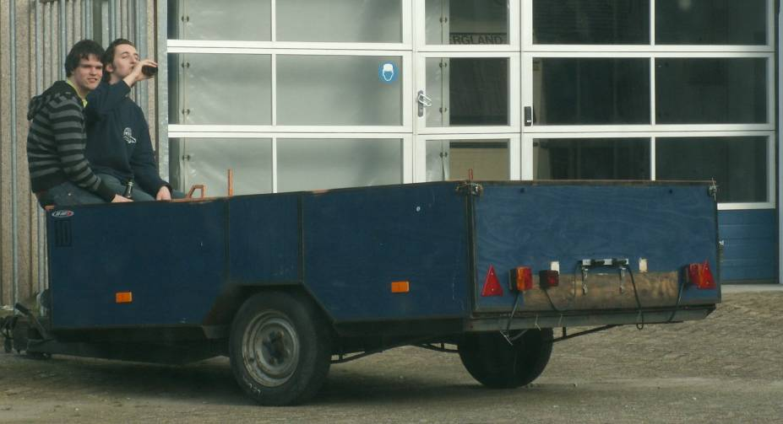
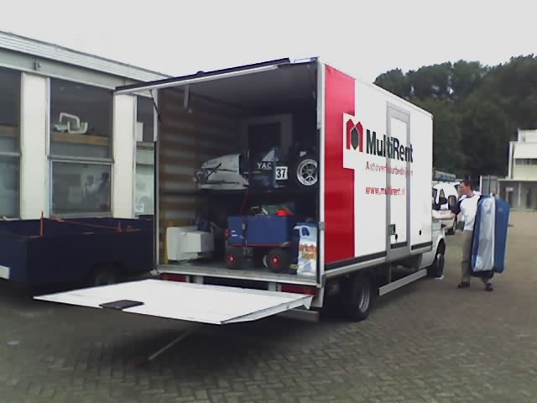
Transport

Slide 20
Rookie and Ace drivers
Aesthetics
Maintenance
Power
Weight
Price
Service
Handling
Transport
Adjustability
Safety

Slide 21
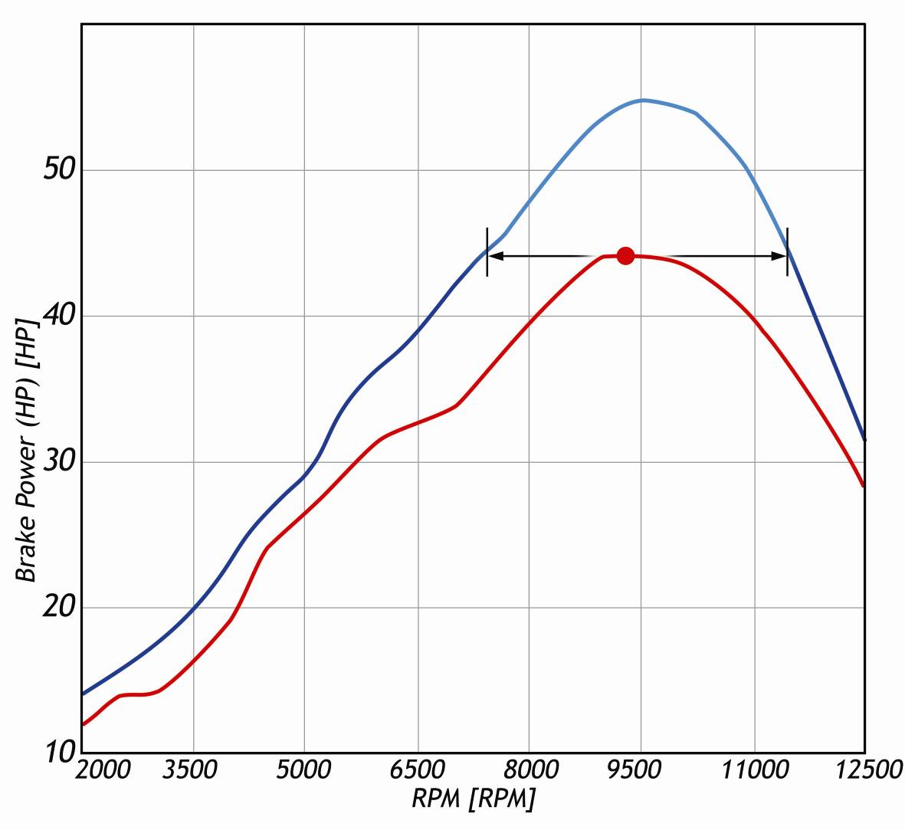
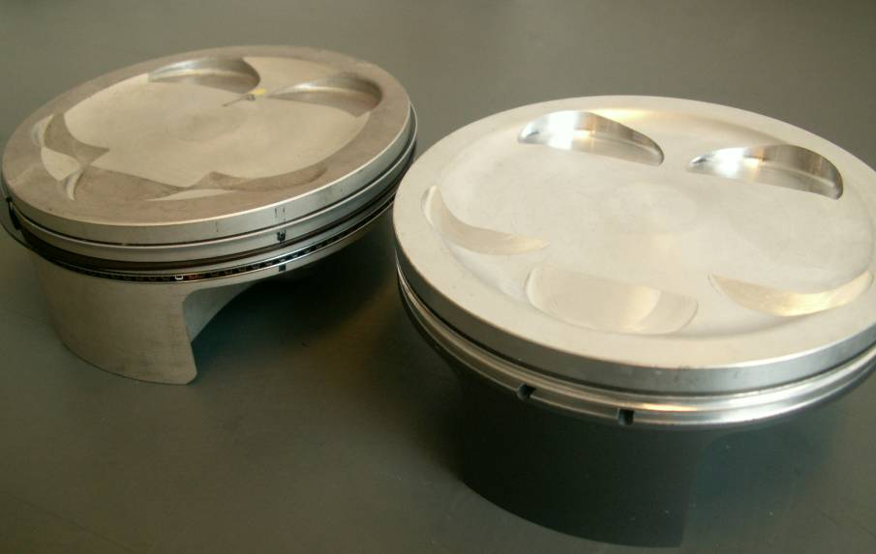
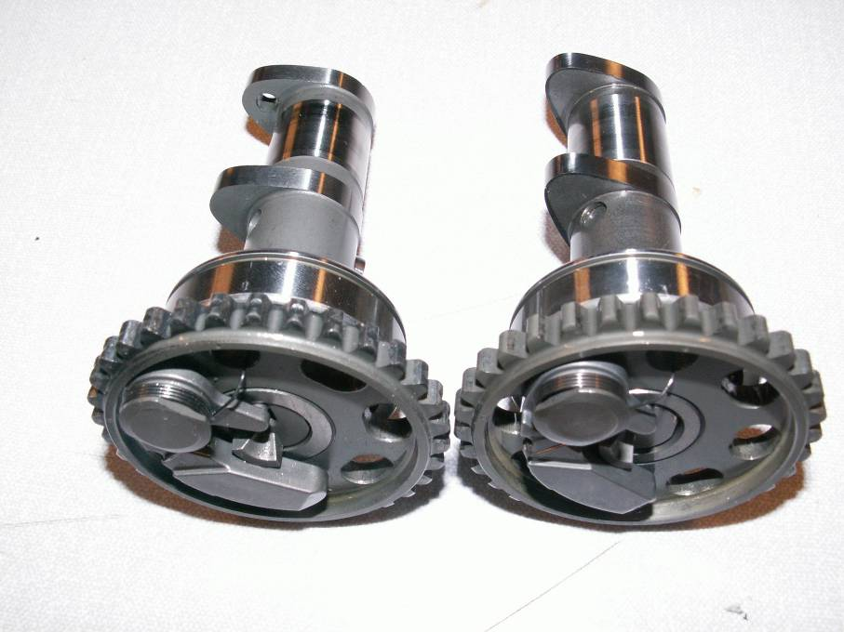
Upgrades: Power
With tuning kit
Without tuning kit

Slide 22
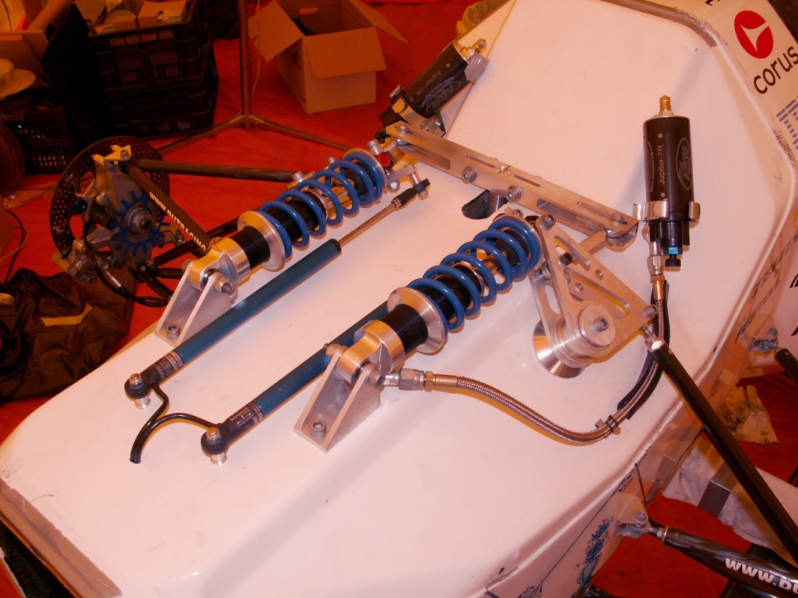
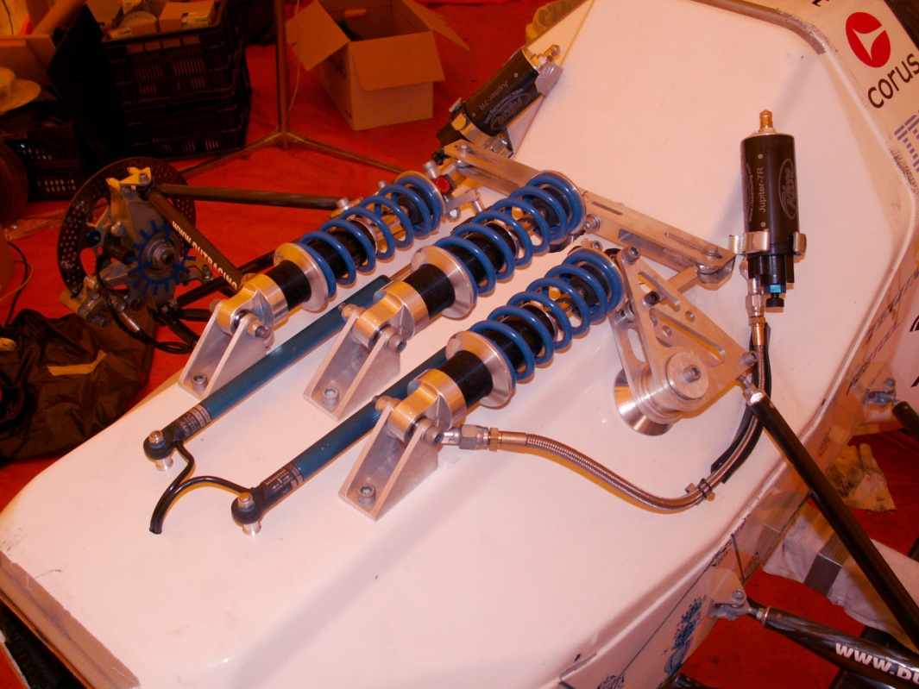
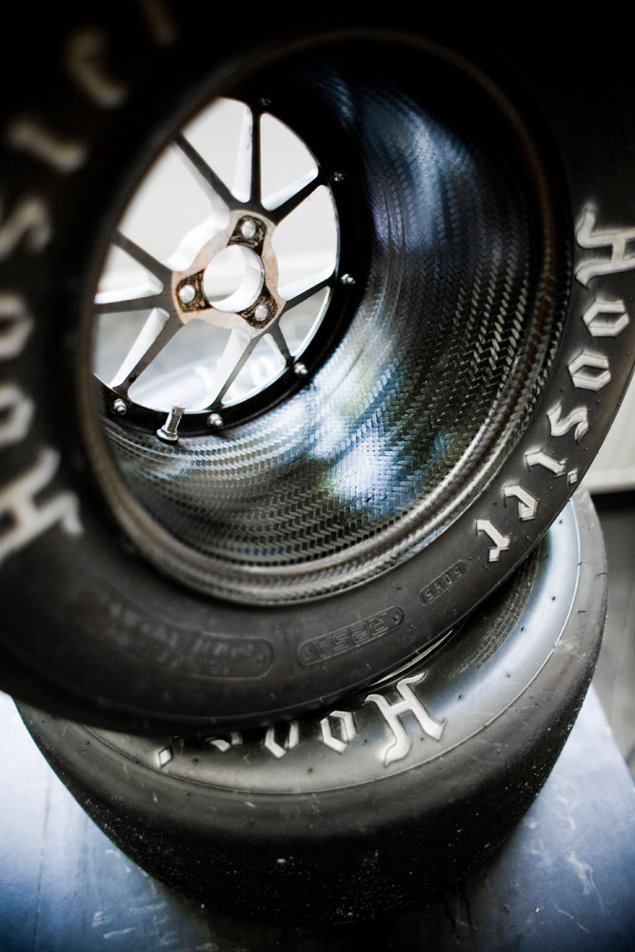
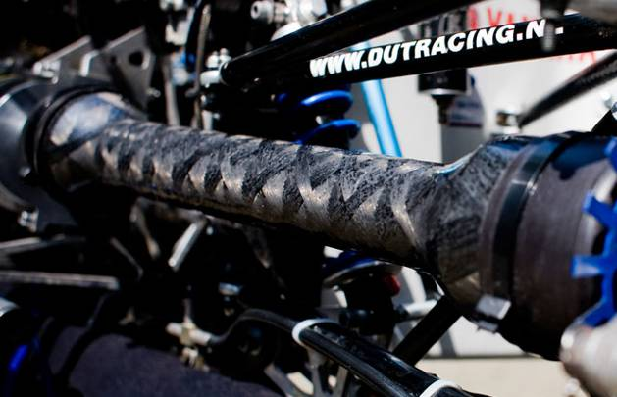
Upgrades: Handling

Slide 23
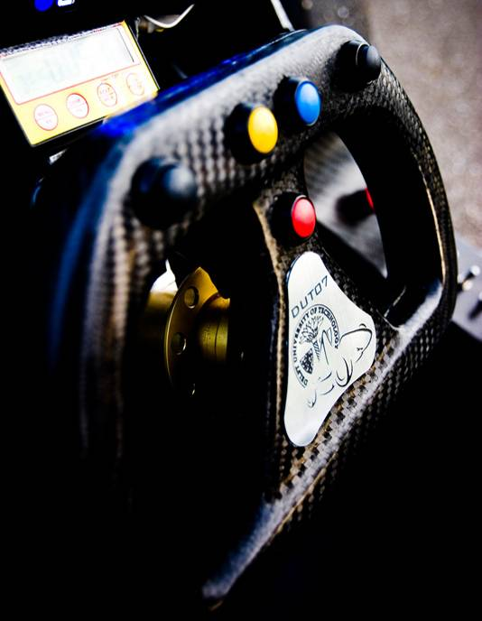
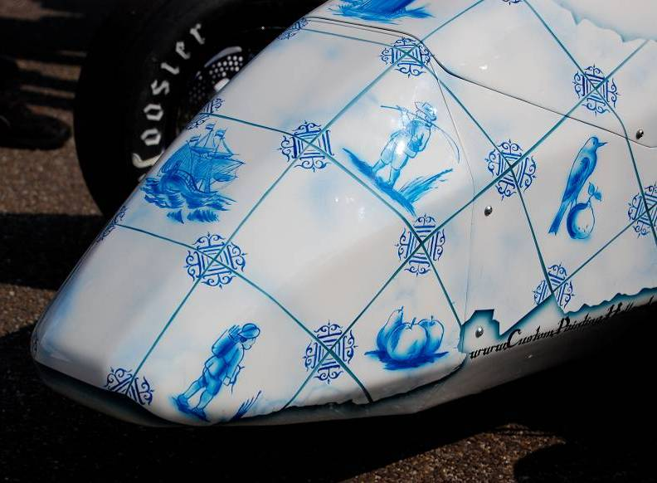
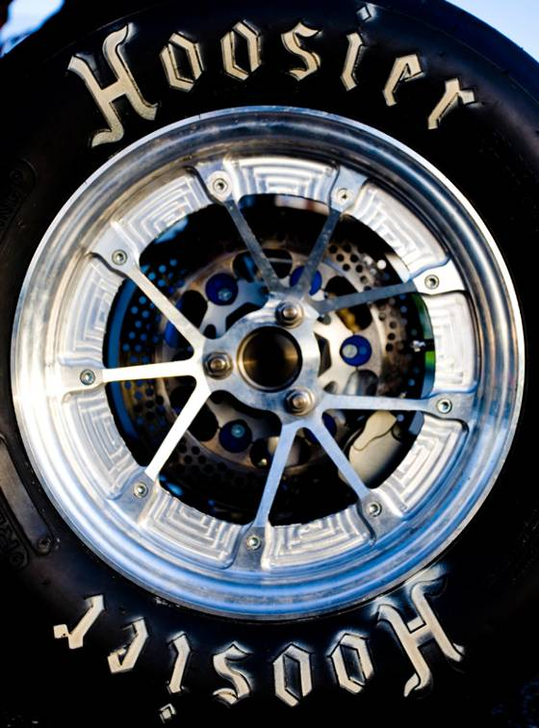
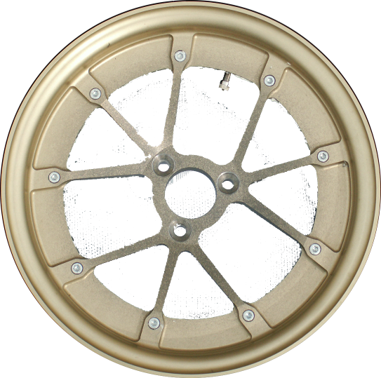
Upgrades: looks

Slide 24


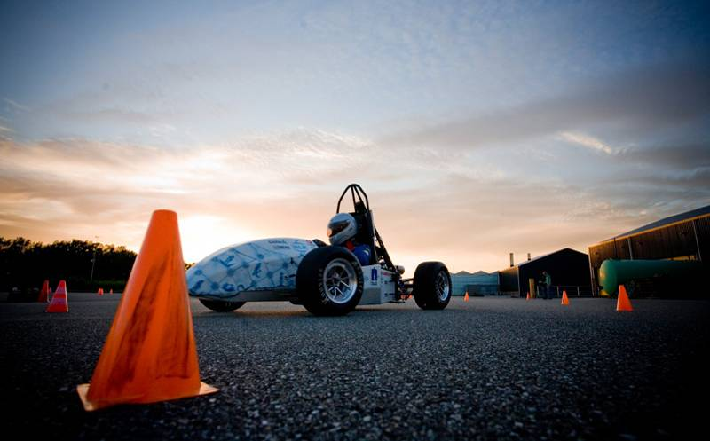
The Razor

Slide 25
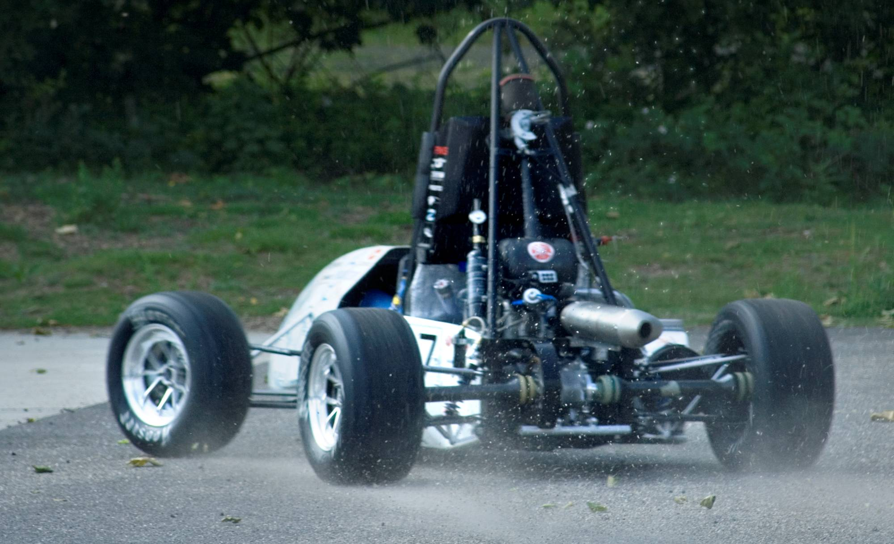
The Razor

Slide 26
Marketshare
4%
16%
16%
20%
Ace
Rookie
64%

Slide 27
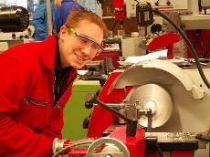
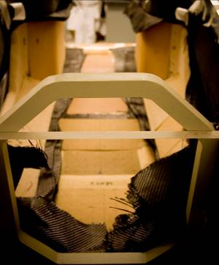
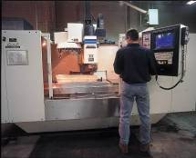
Production
Bonding
Sheet Metal
Casting
Welding
Composite
Outsourcing
In House
CNC
Machining

Slide 28
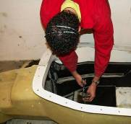
Production
Bonding
Sheet Metal
100 %
Casting
Welding
Composite
Outsourcing
In House
CNC
Machining

Slide 29
Investments
  Workspace 600m2
  Personnel 30 people
  CNC Machines $ 4,000,000
  Vacuum Pumps $ 25,000
  Ovens $ 75,000
  Various Tooling $ 150,000
  Inventory $ 500,000
TOTAL INVESTMENT $ 4,75 Mln
Hier komt nog een plaatje van de fabrieks lay out (2D)

Slide 30
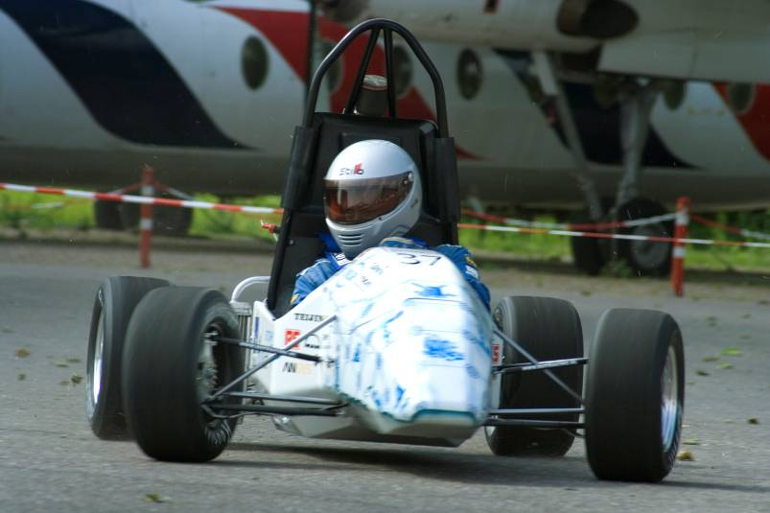
Revenues & expenses
Purchased Parts $ 5200
Raw Material $ 5800
Personnel $ 2100
Marketing & Sales $ 500
Other $ 2800
Retail Price $ 19500
Cost per car $ 16400
Profit per car
$3100

Slide 31
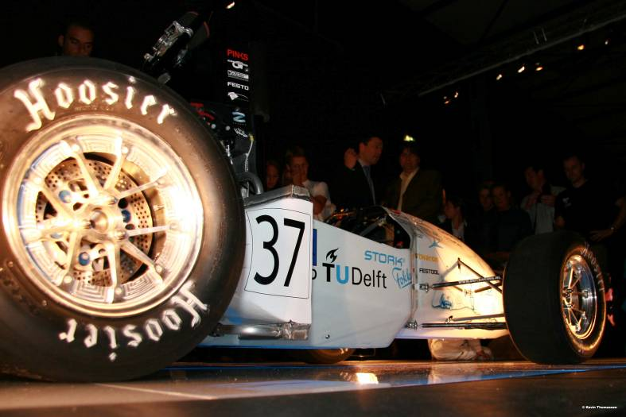
Upgrades
Purchased Parts $ 200
Raw Material $ 300
Personnel $ 100
Marketing & Sales $ 500
Other $ 100
Retail Price $ 5000
Cost per upgrade $ 1200
Profit per upgrade
$3800

Slide 32
Profit
Profit per car
$3100
Profit per upgrade
$3800
Sales Figures 1000 cars per year
200 upgrades
Total Profit per year $ 3,86M
Total Investment $ 4,75M
Break Even Point 15 months !
3,86 M
year !

Slide 33
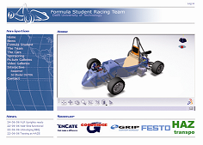
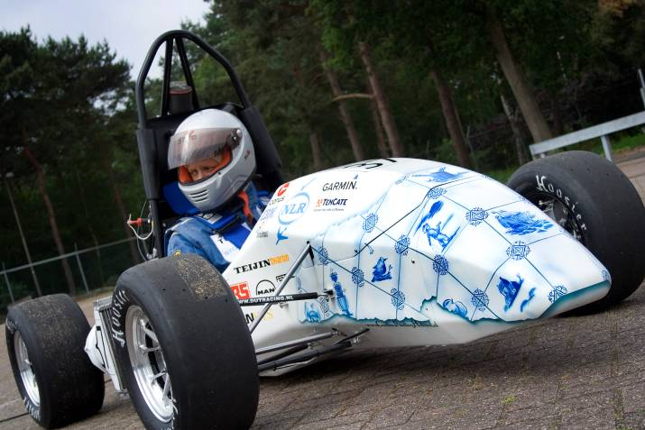
Marketing
Advertising in Car Magazines
Test Drive @ Go-kart track
Sales via Internet
3 Packages - Platinum
- Gold
- Silver

Slide 34




Conclusion
Investment in
Delft Blue Muscle Car is:
$mart, $exy and $afe !!!

Slide 35

Production times
Part | Prod. Process | Prod. Time
Monocoque | VARTM | 8 hours
Uprights | Casting & CNC | 2 + 1 hours
Rims | VARTM | 2 hours
Centers | Casting & CNC | 2 + 1/2 hours
Axles | CNC | 1 hour
Inserts | Machining | 15 minutes
Brackets | Machining | 15 minutes
Rear Bulkhead | Welding | 2 hours
Driveshafts | Filament Winding | ½ hour
Driveshaft Inserts | Machining | 1 hour
Plenum & Restrictor | Filament Winding | 1 hour
Pedal Box | Sheet Metal/Welding | 2 hours

Slide 36

Personnel
Work | # People
VARTM | 10
CNC Machining | 2
Bonding | 2
Assembly | 8
Quality Control | 2
Management | 2
Administration | 2
Marketing & Sales | 2
Total | 30

Slide 37
Marketing
Platinum
Car + Technical Support + Trailer + Spare Parts
- Hand painted Delft Blue appearance
- Pneumatic Shifting System
- Carbon Foam Radiator
delivery (24hr) , Race Guarantee (48 hrs)
Costs 40.000 , Price 55.000 $
Gold
Car + Technical Support + Trailer + Spare Parts
Costs 25.000 , Price 35.000 $
Silver
The Car, Costs 16.400 $ , Price 19.500 $

Slide 38
Market
Racing track
Zandvoort
Go-kart
A’dam etc
N = 85
Price >$30,000
Speed ≈ 200km/h
Fuel Economy 1L/5km
Fast Cornering ++
Power/Weight ratio ++
Looks ++++
Competition ++
Target Group 1/1000
Track Rental ≈$1000/day
Circuits Few
N = 243
<$15,000
≈ 120km/h
1L/10km
+++++
++++
+
++++
10/1000
≈$100/day
Many

